Slide 1



Advanced programming concepts – Boost your C++!
This presentation provides further information on the advanced topic 'Boost’.
By: Bob Aaldering (492152) and Nian Luisman (496439)
Notes:
Door: Nian

Slide 2
content
Introduction to 'Boost’.
What is 'Boost’?
Learning path approach for 'Boost’.
Our own application, which uses 'Boost’.
Some examples of applications, for which 'Boost' is used.
Our 'experience' of working with 'Boost’.
Summary of our topic.
Notes:
Door: Nian

Slide 3

Introduction to ‘boost’.
By default, C++ offers many functionalities within the 'std' namespace.
However, sometimes you want to add more functionalities.
This could be, for example, the following functionalities:
Networking.
Parsing program options.
JSON parser.
Multithreading.
These functions are provided in the 'Boost' libraries.
But what exactly is 'Boost’?
'Boost' mainly uses templates.
'Boost' is also used for research into generic programming and metaprogramming in C++.
But mainly: provide additional features that are not offered in the 'std' namespace.
Notes:
Door: Nian

Slide 4
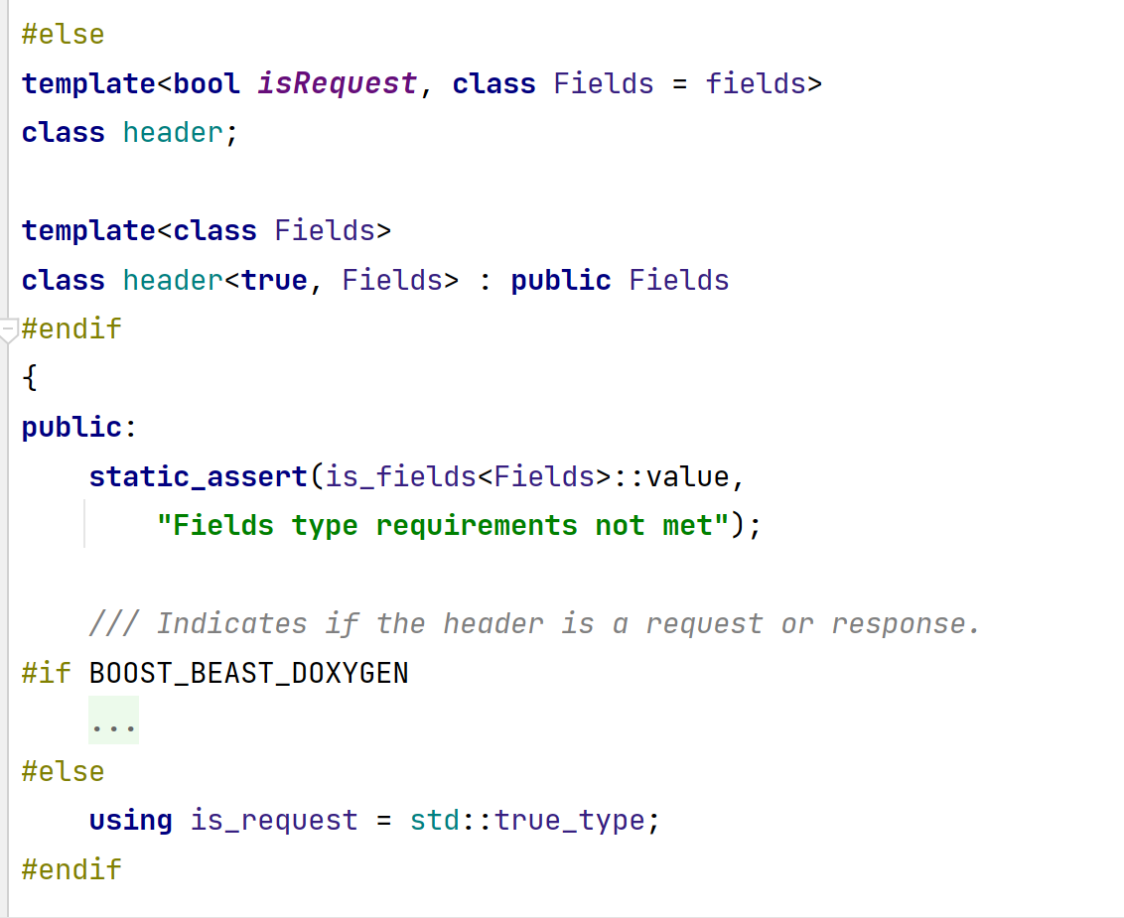
What is 'Boost’?
As mentioned, 'Boost' mainly provides extra functions to a C++ program.
It often works with templates, which makes it possible to work with generic types.
For this reason, 'Boost' can be used for many applications.
It can display graphs based on a sequence of values.
A library for modifying a file system.
And a lot more libraries!
It takes your C++ program to the next level. That is why 'Boost' is also used in business. This is why it is important to get acquainted with 'Boost'.
Almost everything is generic in ‘Boost’.
Notes:
Door: Bob.

Slide 5
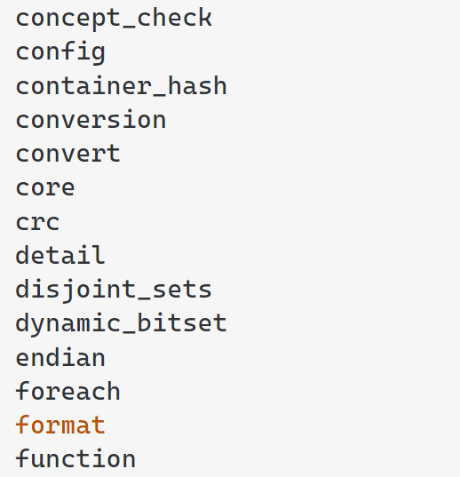
What is 'Boost’?
'Boost' mainly consists of header only libraries, but also a number of libraries that depend on a *.cpp file.
All include files end with *.hpp. This means it is just a C++ header. Combination with C is not possible.
Just a few examples of header-only libraries.
Notes:
Door: Bob

Slide 6
Learning path approach for 'Boost’.
Get acquainted with different parts within 'Boost’.
Boost – program options.
Boost – asio/beast (together with SSL).
Boost – property tree/json parser.
Boost – any.
How to get acquainted with these parts? By making a full application!
Further approach: making a tutorial, in which all parts are explained in detail.
Notes:
Door: Bob

Slide 7
Learning path approach for 'Boost’.
The tutorial includes:
Compiling the complete 'CMakeLists.txt', including an explanation of how to download/add 'Boost’.
Set up various classes, with explanations about this.
Double learning trajectory, namely reflecting again in the tutorial after writing the code.
Notes:
Door: Bob

Slide 8
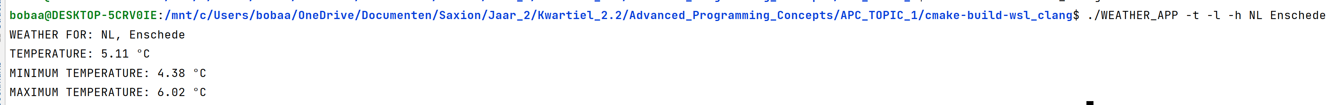
Our own application, which uses 'Boost’.
Our goal: to apply various aspects of 'Boost’.
This makes our application do the following:
Parse program options, which are passed to the main function.
Get the weather for the country and city via a web server.
The web server returns a response, in the form of JSON.
Parse JSON and show weather information to the program based on the options.
All functions use 'Boost'.
Notes:
Door: Nian

Slide 9
Some examples of applications, for which 'Boost' is used.
In business, 'Boost' is used for:
As mentioned, a number of times: possibility for networking.
Implement atomic operations for different CPU architectures.
Interoperability between C++ and the Python programming language.
Greater precision on integer, rational, floating-point, complex and integral types than the standard data types available in C++.
Notes:
Door: Bob

Slide 10
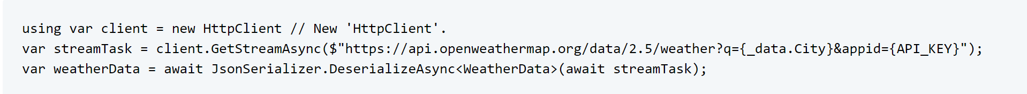
Our 'experience' of working with 'Boost’.
We found it instructive to work with 'Boost’.
Learned a lot for which applications you can also use C++.
But: if you use C++ for networking, for example, this is still more cumbersome than C#.
Big disadvantage of 'Boost': it has little documentation.
Example of networking in C#. It does the same as our application in C++. However, here it can be done in three lines of code.
Notes:
Door: Nian

Slide 11

Summary of our topic.
More functionalities than the 'std' namespace. Think of 'Boost' as an extension.
Mainly uses templates and metaprogramming.
Used in business.
Creating our own application with ‘Boost’ functionalities → weather app.
Questions?
Notes:
Door: Nian

